Slide 1
Dam Removal: The Mitigation Banker’s Experience
J. Adam Riggsbee, PhD
President, RiverBank Conservation, LLC

Slide 2
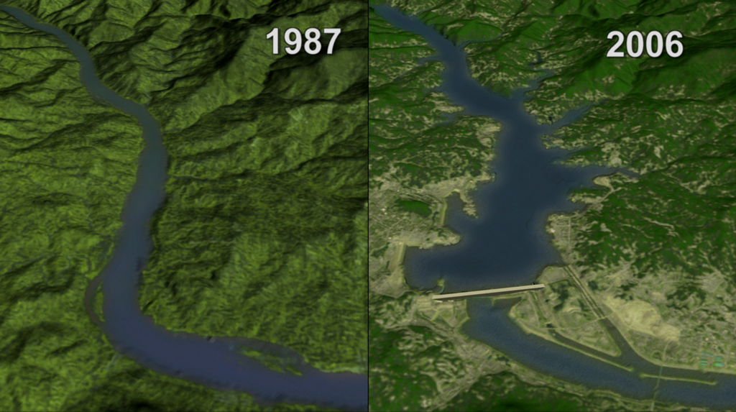

Slide 3
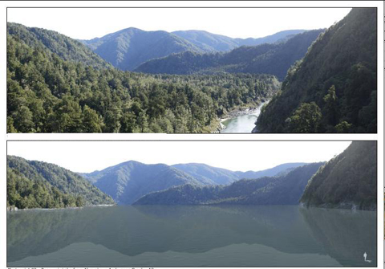

Slide 4
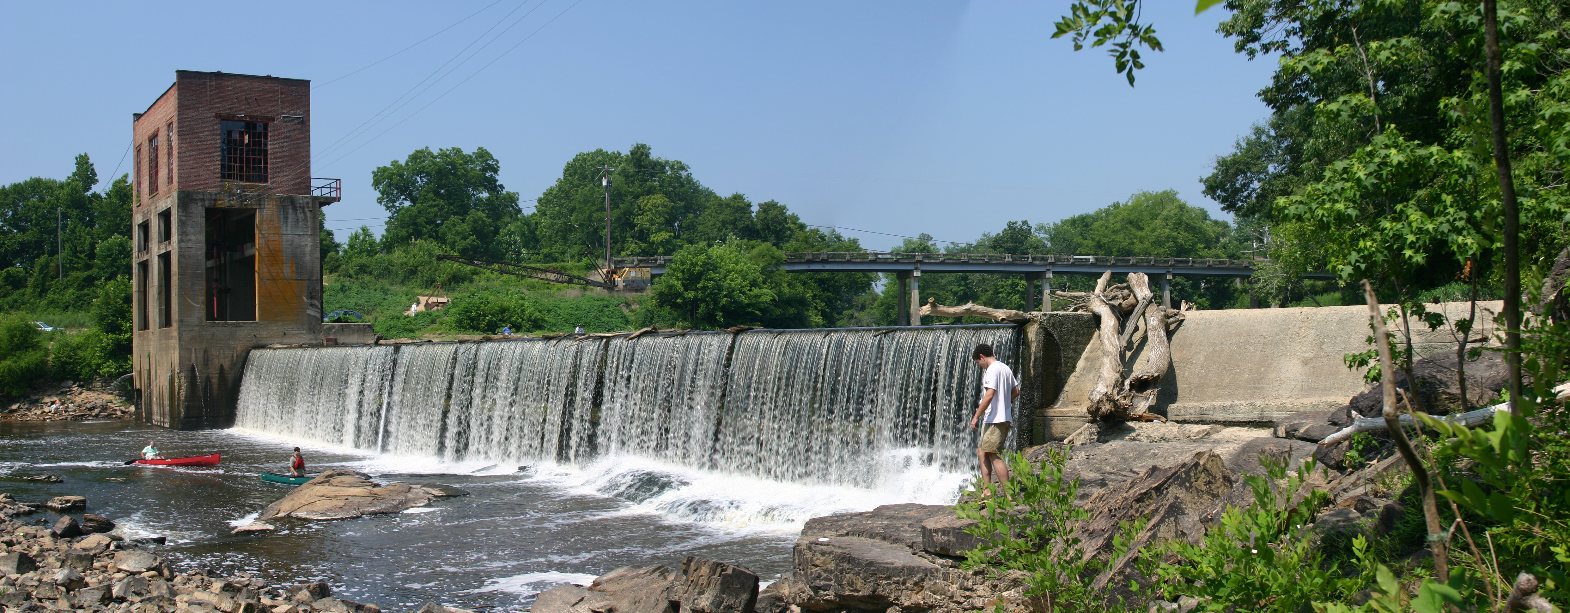

Slide 5
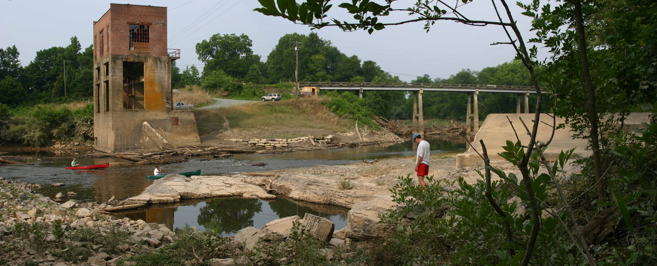

Slide 6
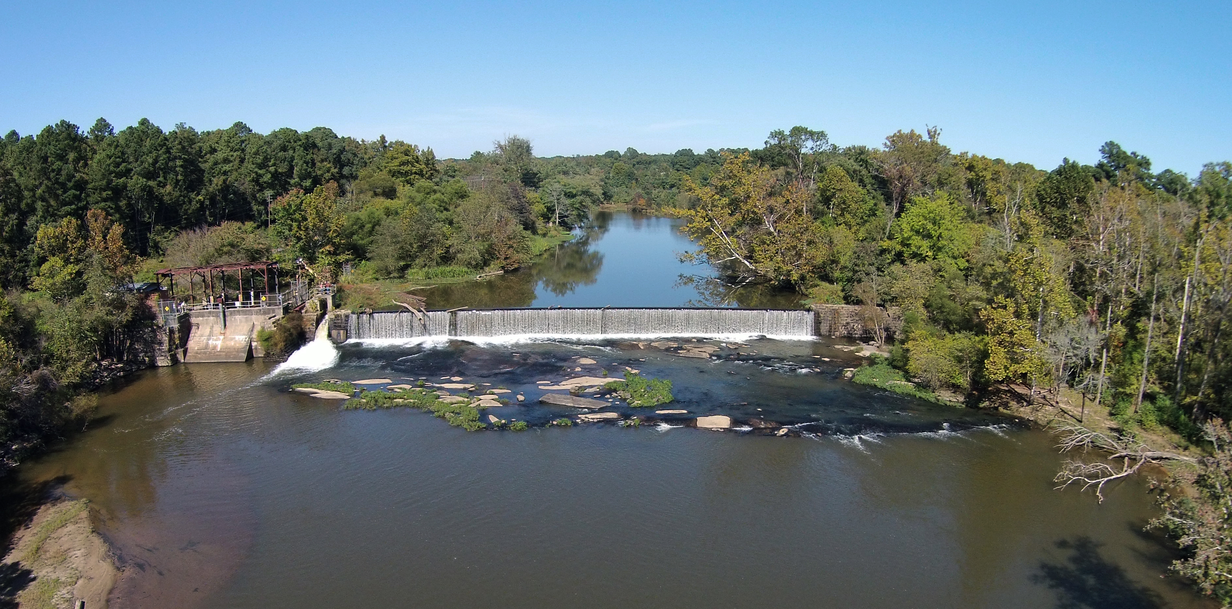

Slide 7
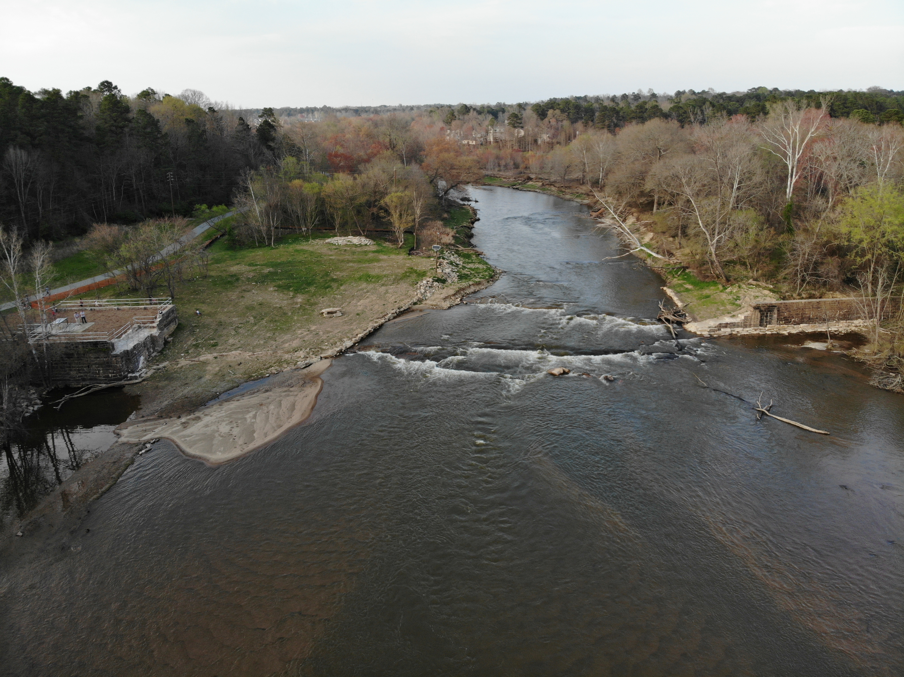

Slide 8


Impounded River
Coarse Delta Deposits
Fine Lake Deposits
Sediment Wedge
adapted from Morris and Fan, 1998, Fig. 10.1

Slide 9
Free-flowing River
adapted from Morris and Fan, 1998, Fig. 10.1

Slide 10
2018 Regulatory Guidance Letter
Classifies dam removal as PBR
Establishes regulatory expectation that, ecologically, dam removal is more likely positive than negative
States the negative effects are most likely short lived and outweighed by benefits
Encourages regional credit determination methods, and separates:
  Channel credits – protection not required
  Riparian credits – protection required
Requires functional monitoring, tied to credit releases
Establishes reasonable expectations for outcomes
Appropriately restrains network connectivity crediting
Provides additional cover for wetland losses aside from NWP 53

Slide 11
Performance Standards Comparison
Natural Channel Design – STATIC
  Stable
    Pattern
    Dimension
    Profile
  Riparian Planting
    Density
    Survival
  Conditional/Functional Assessment
Dam Removal—DYNAMIC
  Biological assemblage shifts
    Lentic to lotic communities
  RTE species recolonization
  Diadromous fishes
    Passage and spawning
  Water quality
    DO
    Temp

Slide 12
Challenges
Performance Standards/Economics
  Case-by-case, based on reference reaches
  Expensive, seasonally-dependent monitoring (baseline and post-demo)
  All leads to extended permitting timelines
Uncertain timing of success:
    NCD monitoring designed to show effort hasn’t failed;
    DR monitoring designed to show WHEN successful ecological transition occurs
    Release-for-performance (2018 RGL)
Administrative issues in need of resolution:
  Sediments and wetland losses (state-level; NWP 53 helps)
  Long-term protection
  Perception of excessive credit generation

Slide 13
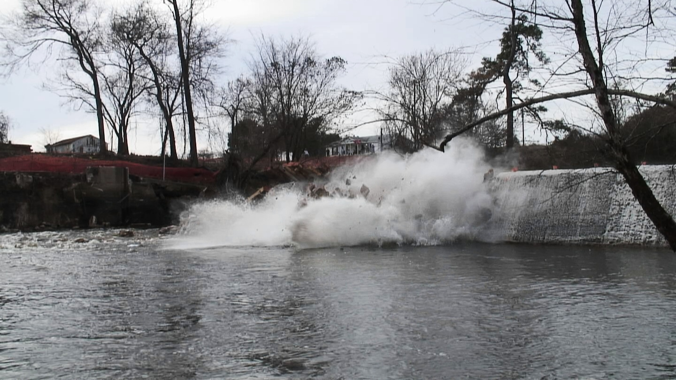
Thank You
adam@riverbankconservation.com
512.241.3775

