Slide 1
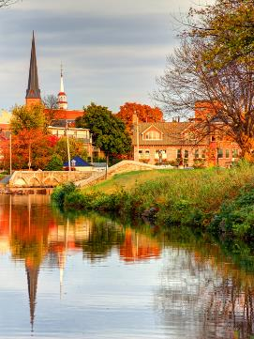
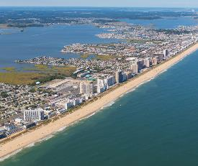
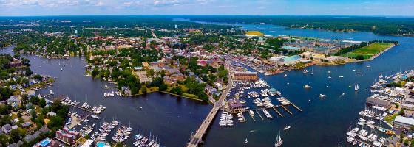
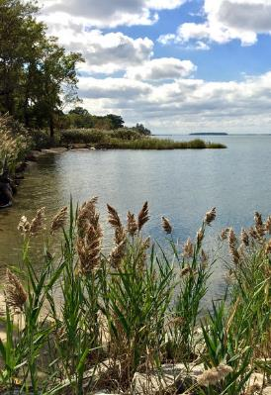
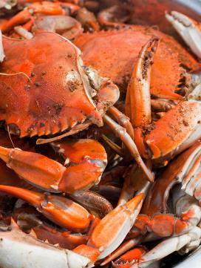
CLIMATE CHANGE AND THE LAW:
MARYLAND EDITION

Slide 2
OUTLINE
INTRODUCTION
1
2
SCOPE AND TRENDS
3
LEGAL LANDSCAPE
4
CLIMATE CASES IN MARYLAND
5
CONCLUSION

Slide 3
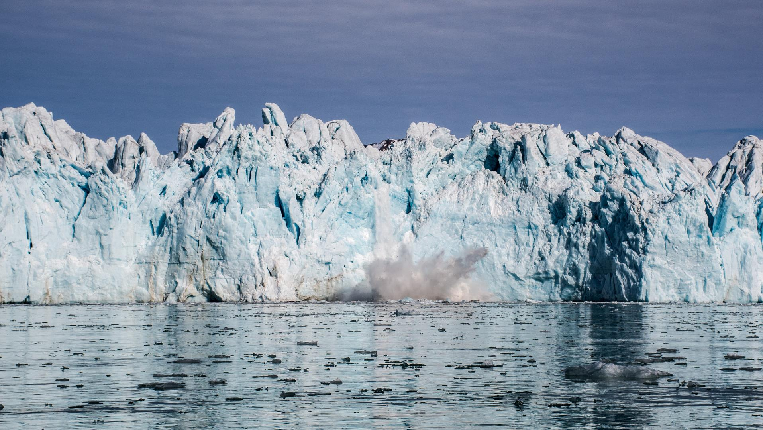
1
INTRODUCTION

Slide 4
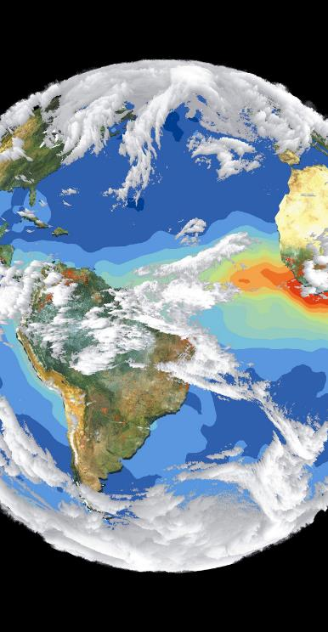
1
INTRODUCTION
INTRODUCTION
Climate change is already affecting people across the United States
Climate science offers a way to understand impacts
Climate cases have increased significantly in the last several years

Slide 5
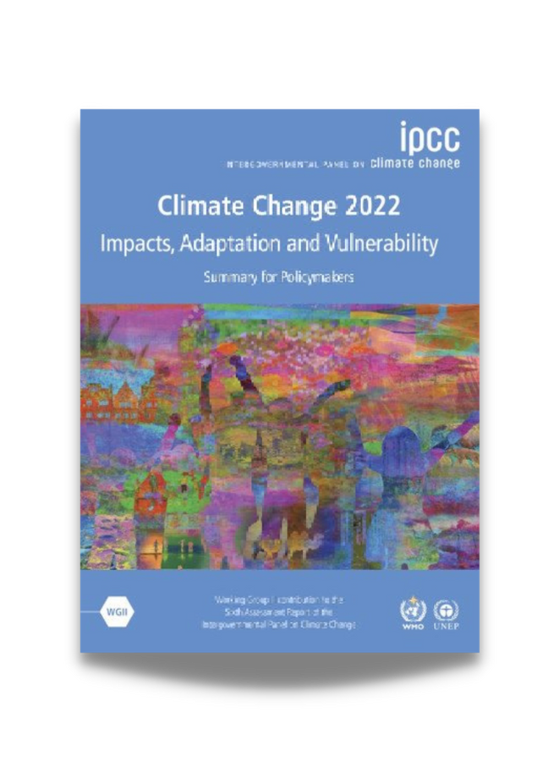
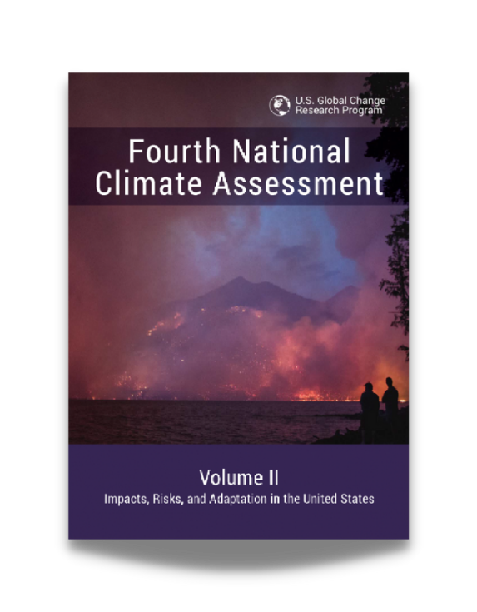
1
INTRODUCTION
SCIENTIFIC CONSENSUS
Intergovernmental Panel on Climate Change (IPCC) Assessment Reports (Synthesis Report for AR6 released March 2023)
U.S. National Climate Assessment (Fifth NCA to be released Fall 2023)
Source: IPCC (2022)
Source: US Global Change Research Program (2018)

Slide 6
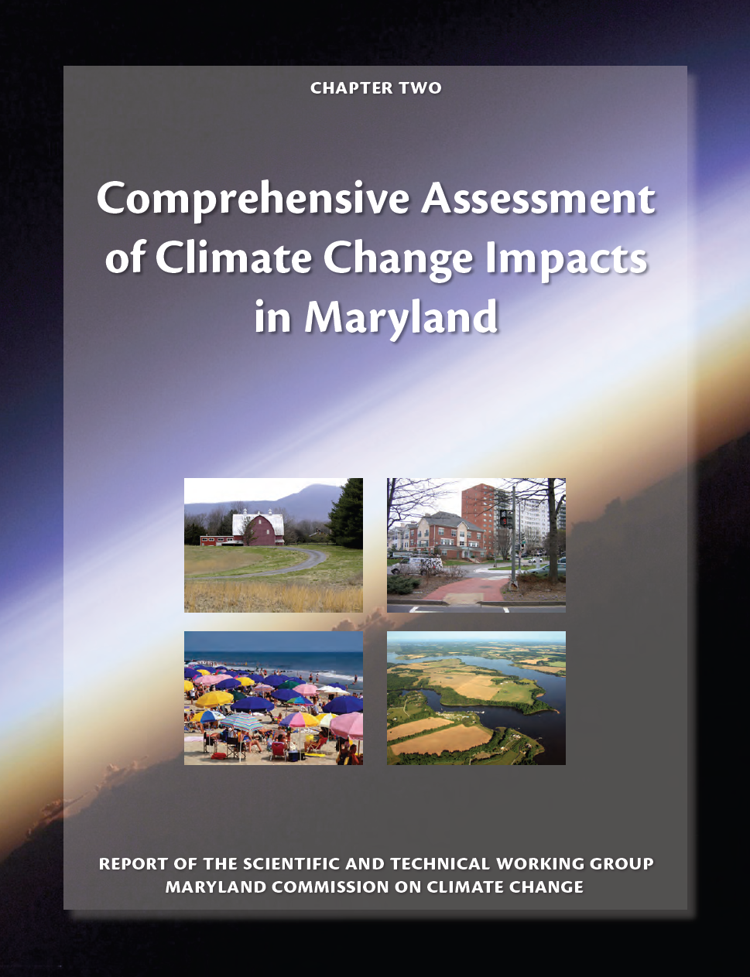
1
INTRODUCTION
CLIMATE SCIENCE - MARYLAND
Annual average temperature is projected to increase by about 3°F by mid-century and is likely unavoidable
Forest productivity in terms of timber produced is likely to decline late in the century
Health risks due to heat stress are very likely to increase
Notes:
State agencies must report to the Governor, the Maryland Commission on Climate Change (MCCC), and General Assembly on the status of programs and activities pertaining to the reduction of greenhouse gas (GHG) emissions.
Maryland Department of the Environment’s (MDE or the Department) Annual Climate Change Report is written in accordance with the Greenhouse Gas Reduction Act (GGRA) reauthorization of 2016. Environment Article §2-1305 requires state agencies to report to the Governor and the Maryland Commission on Climate Change (MCCC), as well as the General Assembly in accordance with §2–1246 of the State Government Article, on the status of programs and activities pertaining to the reduction of greenhouse gas (GHG) emissions.

Slide 7
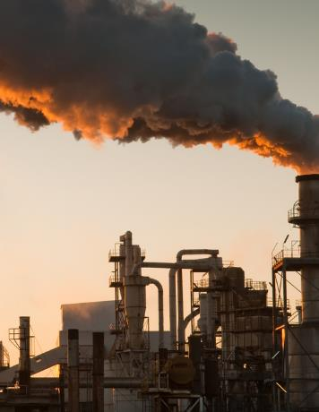
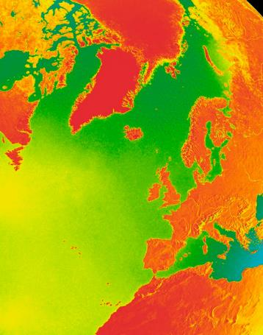
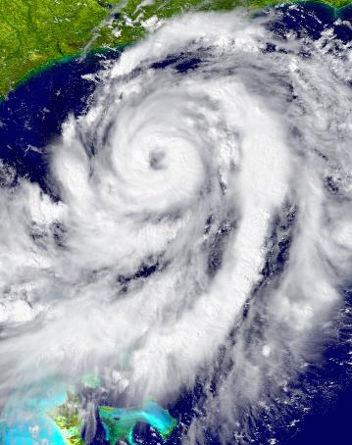
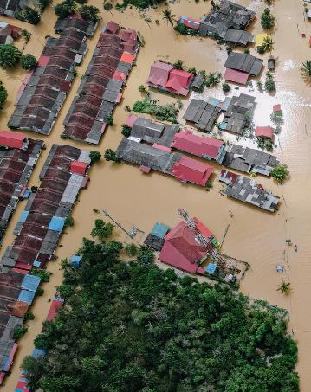
1
INTRODUCTION
ATTRIBUTION SCIENCE
https://climateattribution.org/
Global Climate Change
Physical Impacts
Source
Harm
Source Attribution
Global Climate
Change Attribution
Impact Attribution
Event Attribution
Notes:
Source Attribution asks to what extent have different sectors, activities, and entities contributed to increases in atmospheric GHG concentrations?
Global Climate Change Attribution asks how are human activities affecting the global climate system?
Impact Attribution asks how are changes in the global climate system affecting other interconnected natural and human systems?
Event Attribution asks how are changes in the global climate system affecting the frequency, magnitude, and other characteristics of weather events?

Slide 8
4
HOW SCIENCE ARISES IN CLIMATE LITIGATION
CLIMATE SCIENCE IN CLIMATE CASES
Merits: Courts may use all four types of attribution science when deciding the merits of a case, depending on the cause of action
Remedies:
Source attribution — apportion liability among multiple defendants
Impact & event attribution — calculate the portion of harm attributable to climate change

Slide 9
MANAGING SCIENCE IN COURT
Judge-appointed science experts
Climate science tutorial (Judge Alsup)
Technical advisor
Court-appointed neutrals (formerly known as special masters)
Reference Manual on Scientific Evidence (FJC/NAS)
Notes:
In one now-famous case brought by the California cities of San Francisco and Oakland against numerous oil companies, U.S. District Judge for the Northern District of California William Alsup ordered the parties to organize a tutorial on climate science for him to learn about the issue. He even included a list of eight specific questions to guide the parties’ presentations.

Slide 10
2
SCOPE AND TRENDS

Slide 11
2
SCOPE AND TRENDS
WHAT IS CLIMATE LITIGATION?
01
MITIGATION
02
ADAPTATION AND RISK MANAGEMENT
03
IMPACTS
Notes:
While there are many ways to organize climate cases, one intuitive way is by looking at cases related to (1) mitigation, (2) adaptation, and (3) impacts.
(1) Mitigation refers to reducing the amount of greenhouse gases in the atmosphere through emissions reductions and carbon sequestration. These cases can involve attempting stop or slow fossil fuel-based projects; preserving natural capacity to retain carbon dioxide in forests and wetlands; and facilitating renewable energy technologies
(2) Adaptation and risk management cases relate to adjusting and preparing for the financial, physical, and other risks posed by a changing climate. These cases can involve requests to force adaptation actions, claims of inadequate adaptation, and claims seeking funding for adaptation
(3) Impacts cases are often seeking the mitigation of or compensation for harm caused by the effects of climate change. These cases involve public health impacts, compensation for property damages, and insurance-related disputes, among others.

Slide 12
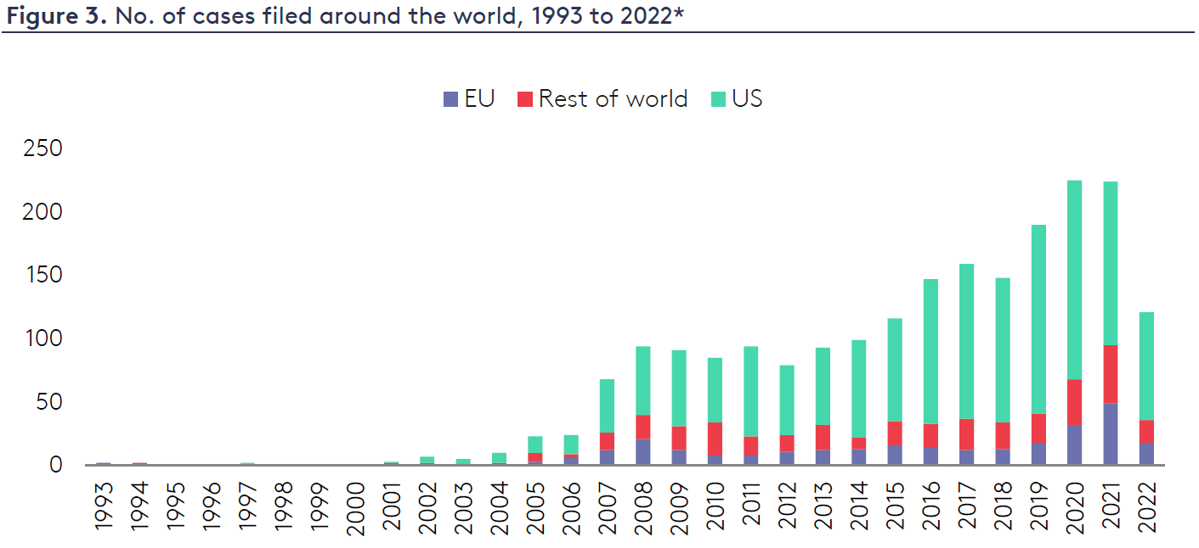
2
SCOPE AND TRENDS
CLIMATE LITIGATION TRENDS
2,300+ U.S. and international climate cases
U.S. - 1,591
Non U.S. - 716
(as of May 15, 2023)
*Chart current through September 2022
Source: Joana Setzer, Harj Narulla, Catherine Higham and Emily Bradeen, Climate Litigation in Europe 6 (December 2022) (based on data from the Sabin Center and Climate Change Laws of the World databases)
Notes:
The Sabin Center for Climate Change Law manages two climate litigation databases, one for the United States and one for other countries. They are both updated regularly.
The database also includes climate litigation cases brought before international or regional courts or tribunals.
A case must meet two criteria to qualify for inclusion in the database.
First, cases must generally be brought before judicial bodies (though in some exemplary instances matters brought before administrative or investigatory bodies are also included). Historically, the term “cases” in the U.S. database included more than judicial actions and proceedings. Other types of “cases” formerly contained in the database included quasi-judicial administrative proceedings, rulemaking petitions, requests for reconsideration of regulations, notices of intent to sue (in situations where lawsuits were not subsequently filed), and subpoenas. Since 2018, these other types of cases have not been added to the U.S. database, and approximately 100 older such cases were removed from the database in November 2021.
Second, climate change law, policy, or science must be a material issue of law or fact in the case. Cases that make only a passing reference to climate change, but do not address climate-relevant laws, policies, or actions in a meaningful way are not included.
In general, cases that may have a direct impact on climate change, but do not explicitly raise climate issues, are also not included in the database. Examples of such cases may include challenges to government inaction on local air pollution or challenges to the development of fossil fuel infrastructure on the basis of other types of harm to human health and/or the environment. The intent of the litigants with regard to the climate-related consequences of such cases is not considered during the assessment process.

Slide 13
2
SCOPE AND TRENDS
U.S. CLIMATE LITIGATION TRENDS*
FEDERAL CASES
STATE CASES
*The majority of climate cases are filed in federal court
most involve federal statutes like the National Environmental Policy Act (NEPA) and Endangered Species Act (ESA)
many involve state impact assessment laws and utility regulation

Slide 14
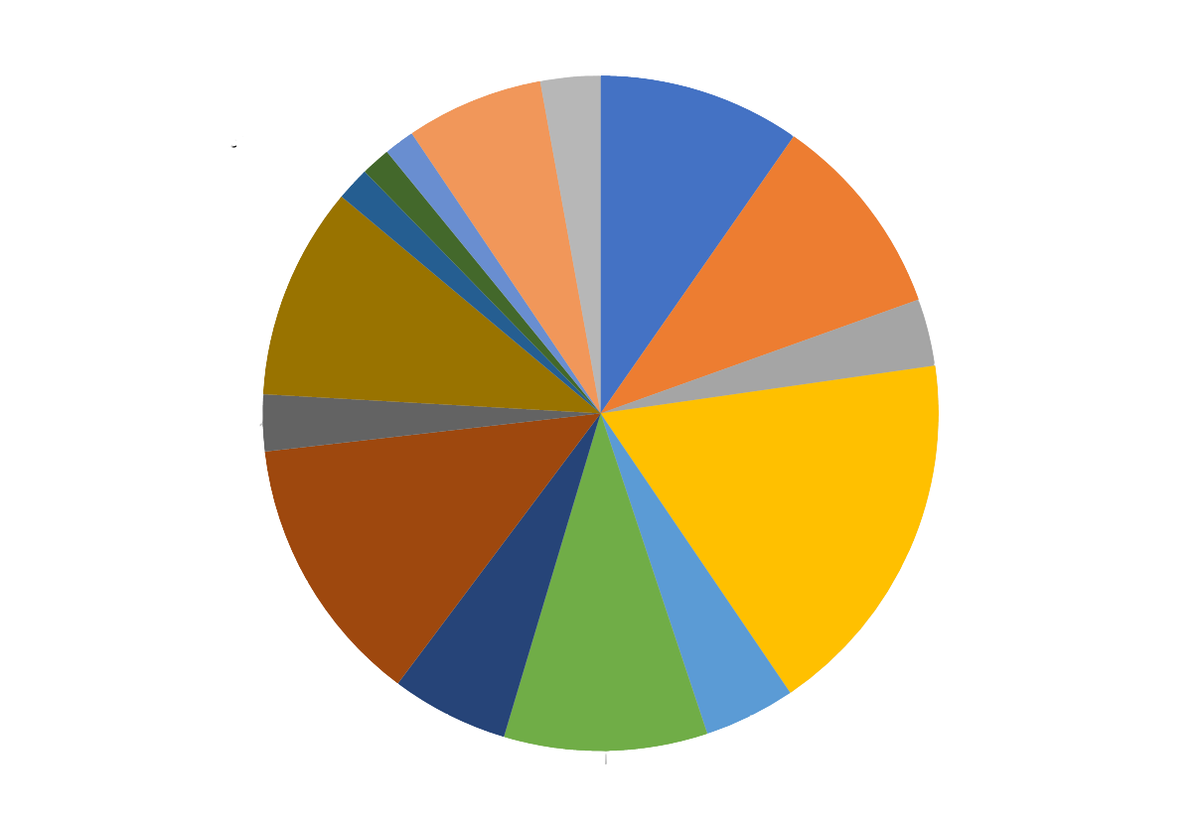
Climate Change Protestors and Scientists, 57
2
SCOPE AND TRENDS
Adaptation, 131
Clean Air Act, 193
Securities and Financial Regulation
Public Trust, 28
Endangered Species Act and Other Wildlife Protection Statutes, 196
Common Law Claims, 32
Other State Law Case Categories, 203
Clean Water Act, 64
State Utility Regulation, 54
National Environmental Policy Act, 354
State "Little NEPA", 258
Constitutional, 112
Freedom of Information Act, 87
Other Federal Statutes, 194
Notes:
Data current as of May 1, 2023

Slide 15
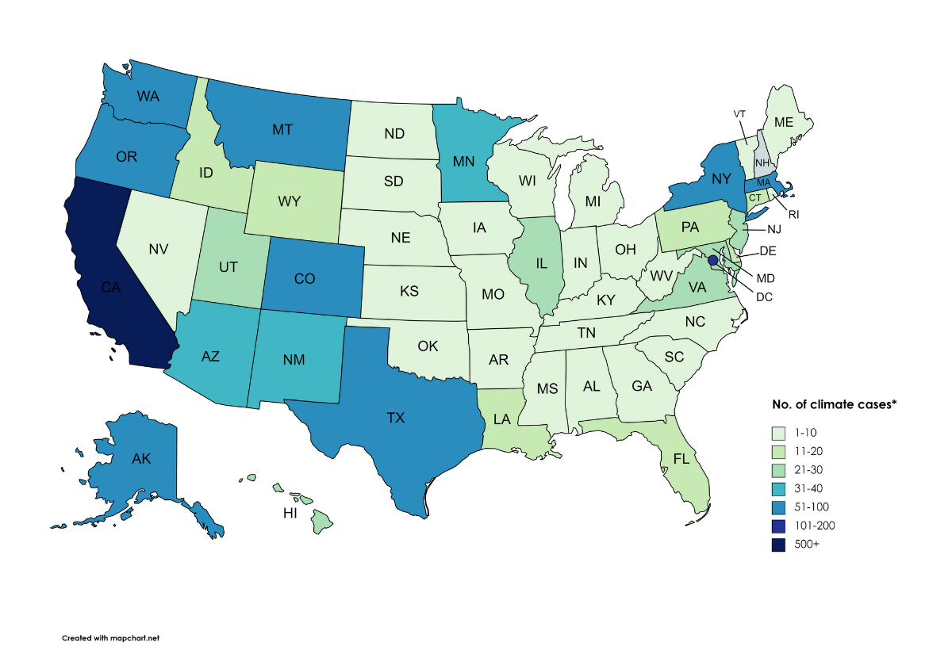
2
SCOPE AND TRENDS
U.S. CLIMATE LITIGATION BY STATE
This chart is based on cases in state courts, before state agencies, and in federal district courts. it does not include cases in circuit courts.
*some cases may be counted more than once if they appeared before more than one adjudicatory body

Slide 16
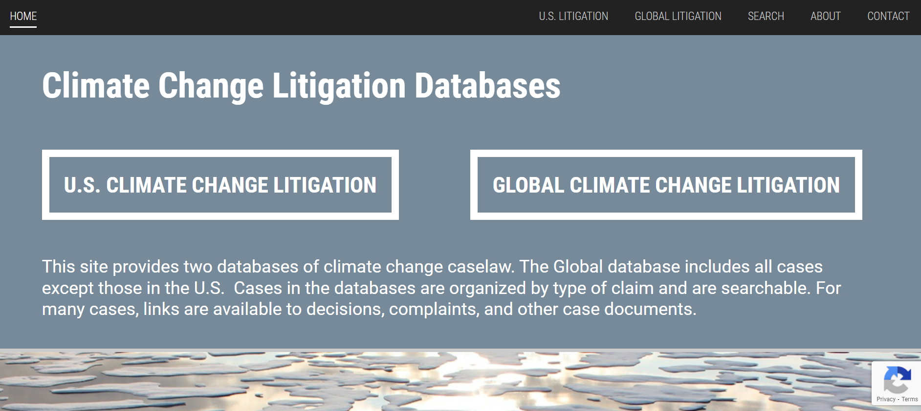
2
SCOPE AND TRENDS
CLIMATE LITIGATION DATABASE
http://climatecasechart.com/

Slide 17
3
LEGAL LANDSCAPE

Slide 18
3
LEGAL LANDSCAPE
LEGAL LANDSCAPE
PARTIES
JURISDICTION
CLAIMS & LEGAL ISSUES
REMEDIES
Governments
Private companies
NGOs
Individuals
Federal or State?
Justiciability
Constitutional and rights-based
Statutory and administrative
Common law
Damages
Injunction
Declaratory
Accounting

Slide 19
3
LEGAL LANDSCAPE
Cases involve claims by: individuals, industry, and NGOs against state and municipal governmental bodies
The argument: Environmental review conducted was deficient
Failure to adequately disclose, analyze, or mitigate climate impacts of the project
Failure to adequately consider climate impacts on the project
No (supplemental) environmental review was conducted
STATE ENVIRONMENTAL REVIEW LAWS

Slide 20
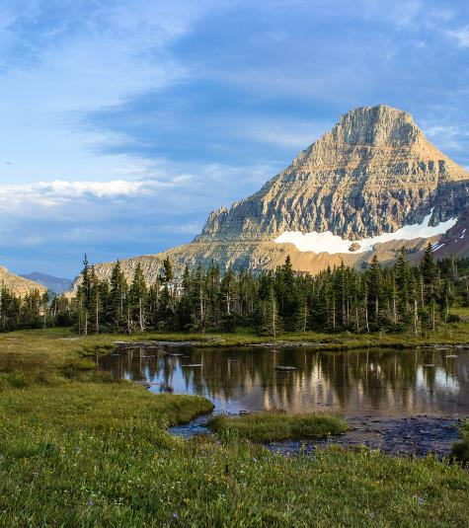
3
LEGAL LANDSCAPE
CONSTITUTIONAL RIGHTS
Claiming governments are undermining fundamental rights by contributing to climate change
Declaratory and injunctive relief
Cases
NGO with 50-state strategy (HI, MT, UT...)
Similar federal case: Juliana

Slide 21
3
LEGAL LANDSCAPE
CONSTITUTIONAL RIGHTS
Hawaii Constitution “[a]rticle XI, section 9’s ‘clean and healthful environment’ right as defined by [Hawaii law] subsumes a right to a life-sustaining climate system,” The right to a life-sustaining climate system is not just affirmative; it is constantly evolving.
In the Matter of the Application of Maui Electric Co., Ltd., SCOT-21-0000041 n.15 (Sup. Ct. Haw. Mar. 2, 2022).

Slide 22
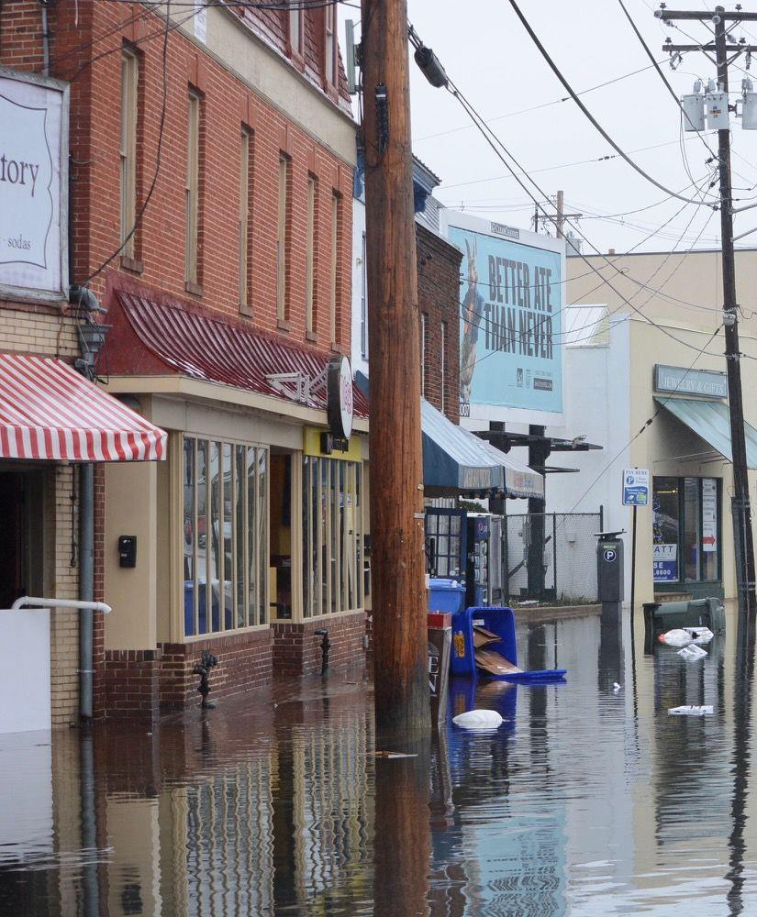
3
LEGAL LANDSCAPE
Cases involve claims by: states/counties/cities against fossil fuel companies
The argument: corporations engaged in deceptive sales and marketing campaigns resulting in damaging climate impacts
The defense: unique federal interests
4/24/2023 - U.S. Supreme Court denies cert. on jurisdictional question
CORPORATE ACTION

Slide 23
3
LEGAL LANDSCAPE
Annapolis is alleging impacts to:
inundation of property -- City, historic, private, businesses
loss of tax revenue
infrastructure and utility damage
increased maintenance costs
increased planning costs
damage to cultural assets
population displacement and/or disruption
tourism-based impacts and revenue loss
MARYLAND
BALTIMORE V. BP
ANNAPOLIS V. BP
ANNE ARUNDEL COUNTY V. BP

Slide 24
3
LEGAL LANDSCAPE
CORPORATE ACTION
“This is an unprecedented case for any court, let alone a state court trial judge. But it is still a tort case. It is based exclusively on state law causes of action. . . . Here, the causes of action may seem new, but in fact are common. They just seem new—due to the unprecedented allegations involving causes and effects of fossil fuels and climate change. Common law historically tries to adapt to such new circumstances.”
City & Cty. of Honolulu & BWS v. Sunoco, LP, No. 1CCV-20-0000380, 2, 7 (Haw. 1st Cir. Ct. Feb. 22, 2022).

Slide 25
4
CLIMATE CASES IN MARYLAND

Slide 26
4
CLIMATE CASES IN MARYLAND
CLIMATE LITIGATION - MARYLAND
CHANGES TO PROPERTY RIGHTS
MORE WATER
MORE HEAT
ENERGY TRANSITION
SHIFTS IN INDUSTRY

Slide 27
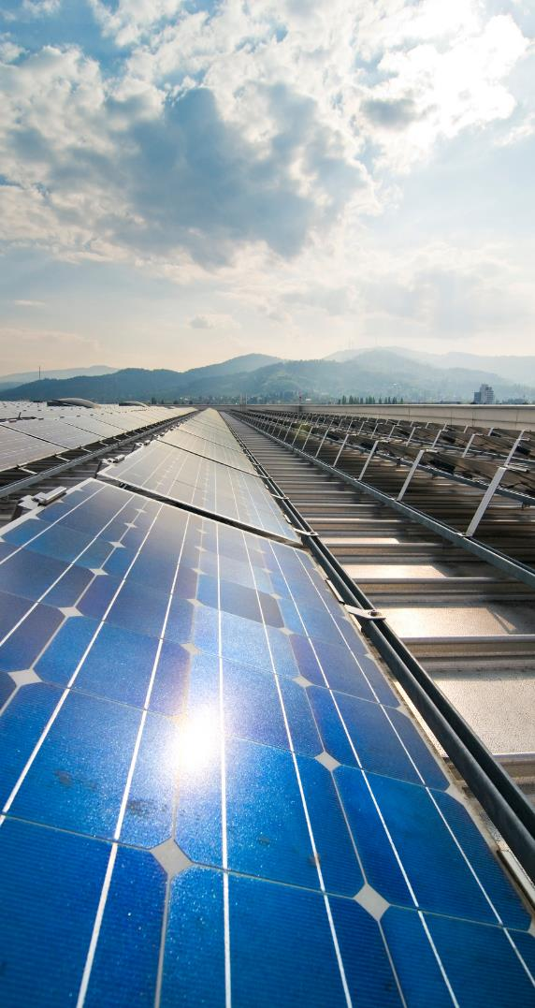
4
CLIMATE CASES IN MARYLAND
ENERGY (RENEWABLES)
Board of County Commissioners of Washington County v. Perennial Solar, LLC, No. 66 (Md. 2019)
Maryland Court of Appeals affirmed that state law preempts local zoning authority with respect to solar energy generating systems that require a Certificate of Public Convenience and Necessity from Maryland PSC
Maryland Office of People's Counsel v. Maryland Public Service Commission, No. 15 (Md. 2018)
Maryland Court of Appeals affirmed decision upholding PSC's approval of Exelon's acquisition of Pepco Holdings, and its utility subsidiaries. Speculative harm to distributed generation markets

Slide 28
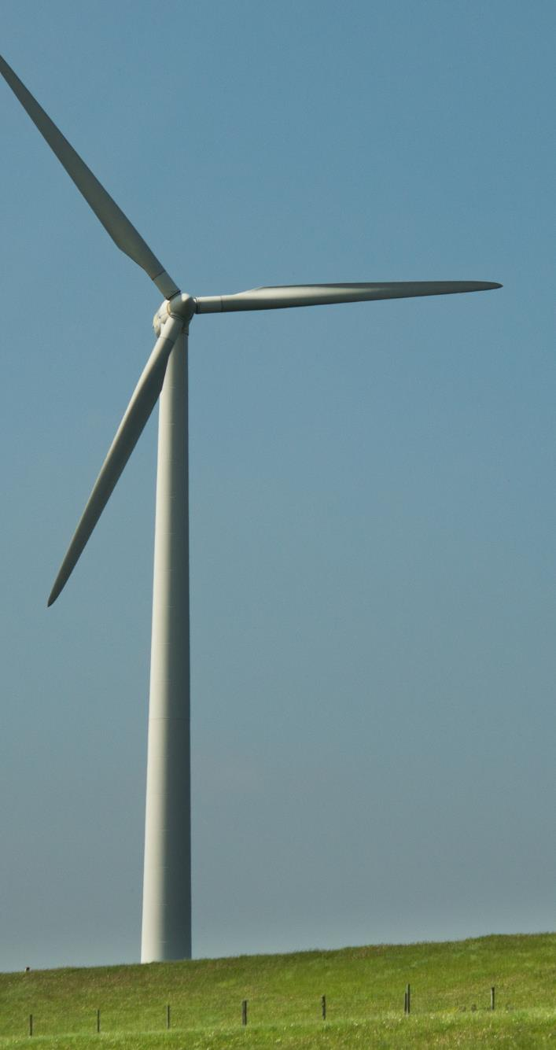
4
CLIMATE CASES IN MARYLAND
ENERGY (RENEWABLES)
Maryland Office of People's Counsel v. Maryland Public Service Commission, No. 2173 (Md. Ct. Spec. App. 2015)
Maryland Court of Appeals upholding PSC-authorized grid resiliency charge in response to state task force recommendations to address climate impacts and prolonged power outages brought on by extreme weather events
In re Frederick County, No. 37 (Md. Ct. Spec. App. 2022)
Rejecting challenge to 20 MGW solar facility. Goals of air quality, clean energy, greenhouse gas neutrality, and energy independence, were consistent with the facility

Slide 29
4
CLIMATE CASES IN MARYLAND
ENERGY (FOSSIL FUELS)
Dominion Cove Point LNG, L.P. v. Sierra Club, No. C12-598
Accokeek, Mattawoman, Piscatawa Creek Communities Council, Inc. v. Maryland Public Service Commission, No. 26, S.T.
Md. Cir. Ct. 2013
Court concluding agreement between Dominion Cove and Sierra Club permitted construction and operation of facilities, and permitted the export of LNG
Md. 2016
Upholding PSC approval for electric generation station to power LNG facility. Tax issue.

Slide 30
LEGAL ISSUES RELATED TO
SEA LEVEL RISE
PUBLIC HEALTH
PLANNING
CORPORATE ACTION
PROPERTY
WILDLIFE

Slide 31
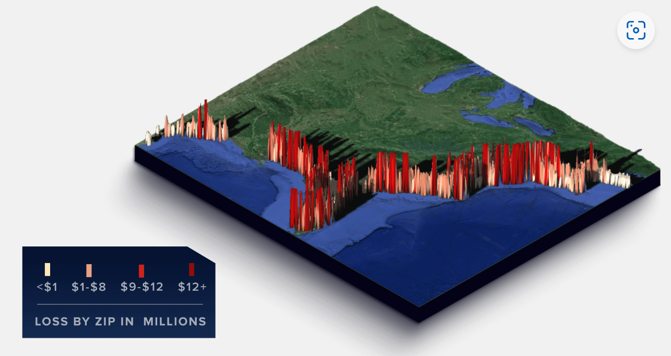
3
LEGAL LANDSCAPE
PROPERTY VALUES
Increased tidal flooding driven by sea level rise has eroded $15.9 billion in relative property values between 2005 and 2017.*
$555.7 million in Maryland
*18 states along the East and Gulf Coasts
Source: First Street Foundation, State by State Analysis: Property Value Loss from Sea Level Rise (2019)
Notes:
Data scientists from First Street Foundation and Columbia University expanded their peer-reviewed housing market research to include approximately 3.7 million coastal properties in Maryland, Delaware, and Pennsylvania, finding increased tidal flooding caused by sea level rise has eroded $862.1 million in relative property values between 2005 and 2017.
MID-ATLANTIC DATA
Among the three latest states analyzed, coastal properties in Maryland were hit hardest, losing $555.7 million in relative appreciation.

Slide 32
5
CONCLUSION

Slide 33
5
CONCLUSION
KEY TAKEAWAYS
1
2
3
More impacts means more cases
Climate science and law will interact
Judges need resources to better understand and prepare for these cases

Slide 34
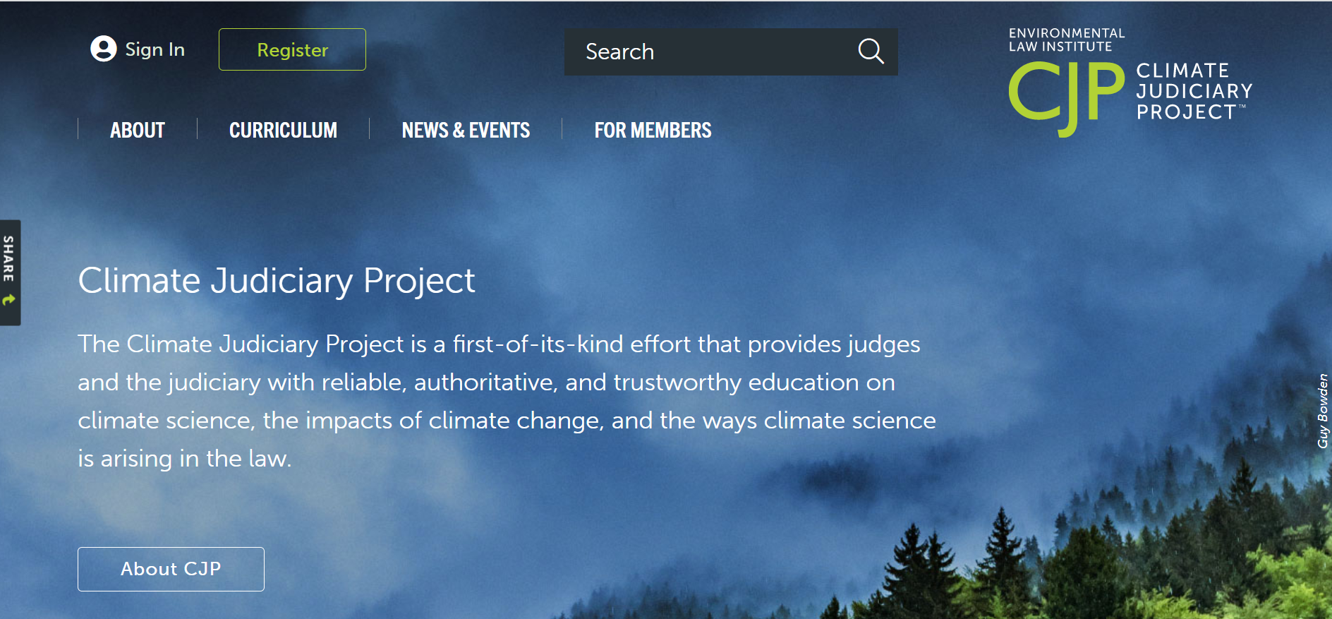
5
CONCLUSION
CJP RESOURCE WEBSITE
cjp.eli.org

Slide 35
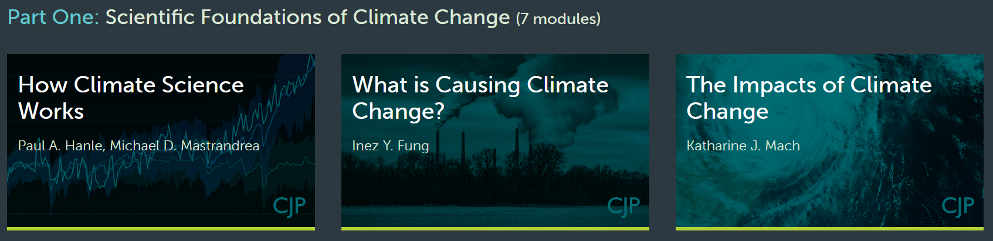
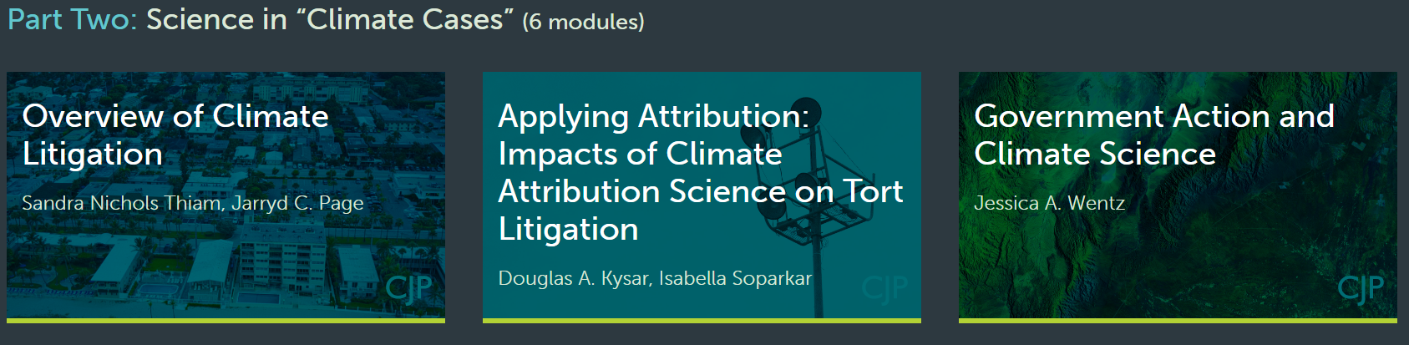
CJP CURRICULUM

Slide 36
5
CONCLUSION
WEBSITE REGISTRATION

Slide 37
5
CONCLUSION
CONTACT US
Climate Judiciary Project
cjp.eli.org
cjp@eli.org

